Slide 1
使用卷積傳遞函數進行聲學傳遞函數半盲估計以應用於去混響 Semi-Blind estimation of acoustic transfer functions with application to dereverberation using convolutive transfer functions Date：2023. 12. 25
Telecom Electroacoustics Audio(TEA) Lab
Presenter:
Anchi Yuan
Notes:
Hello everyone
I’m today’s presenter siang. I’m going to share some of my present work in source separation problem. My topic is comparative studies of source separation using semi-blind and blind source separation approaches.

Slide 2
Outline
Motivation
Literature review
Flow chart of proposed method
Proposed method
Simulations
Summary
Future work
References

Slide 3

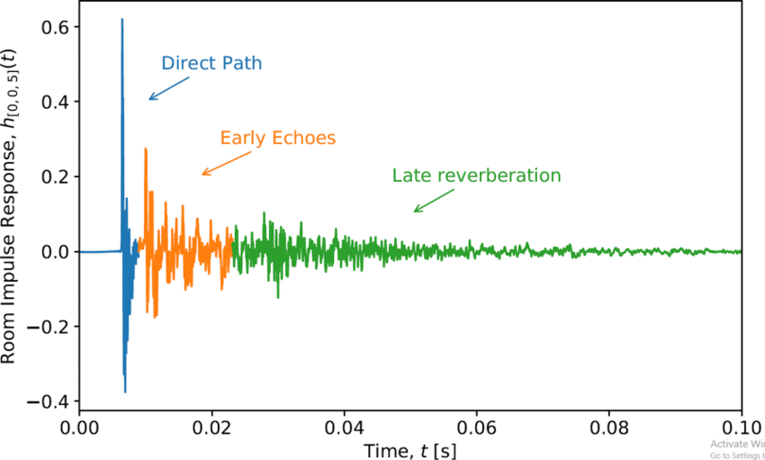


Motivation
Acoustic transfer functions (ATFs) v.s. Relative transfer functions (RTFs)
Unavailability of the source signal
Most blind system identification (BSI) → multiplication transfer function (MTF)
Proposed method → convolutive transfer function (CTF)
ATF
RTF
Magnitude
Time samples

Slide 4
Literature review
Subspace (SS) algorithm
[3]
Higher-order statistics
[1]
Second-order statistics (SOS)
[2]
Cross relation (CR) algorithm
[4]
Slow convergence
local minimum
Blind system identification (BSI)
Computatioally intensive
Difficult in adaptive mode
Time domain adaptive eigenvalue decomposition
algorithm (TAEDA)
[5]
Frequency domain adaptive eigenvalue decomposition
algorithm (FAEDA)
[6]
Short RIR

Slide 5

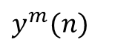
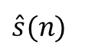
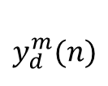
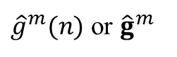

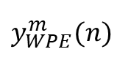
Flow chart of proposed method
$$y_{d}^{m}(n)$$
Delay
Proposed three approaches
Parameters optimization
WPE
DAS
beamformer
$y^{m}(n)$
$y_{WPE}^{m}(n)$
s_{DAS,p}
$\hat{A}$
$\hat{A}$
$\hat{s}(n)$
${\hat{g}}^{m}(n)$ or ${\hat{g}}^{m}$
MINT dereverberation
ATF reconstruction

Slide 6
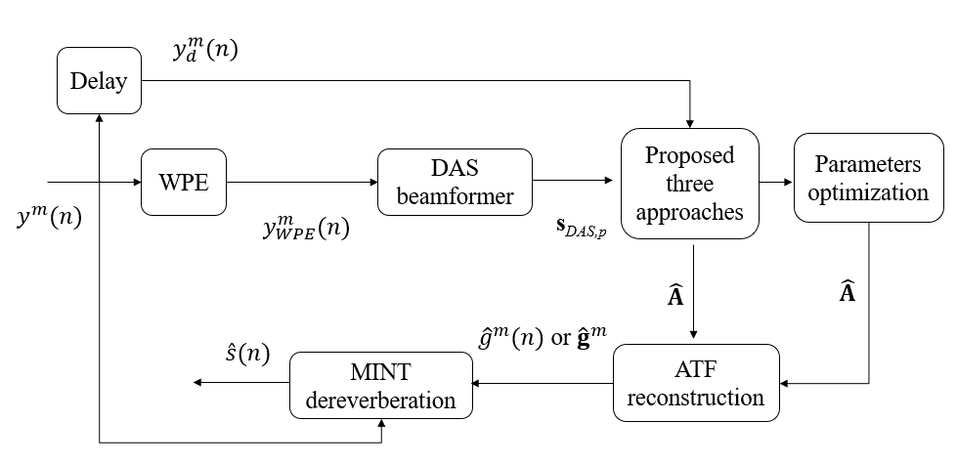
Proposed method
Signal model
Pre-processing
Wiener filter approach
RLS approach
Kalman approach
ATF reconstruction
Parameters optimization
MINT dereverberation
Summary of proposed method

Slide 7
Signal model

Slide 8
Pre-processing
WPE for dereverberation
DAS beamformer for extraction of source signal

Slide 9
WPE
Time samples
C

Slide 10
WPE

Slide 11
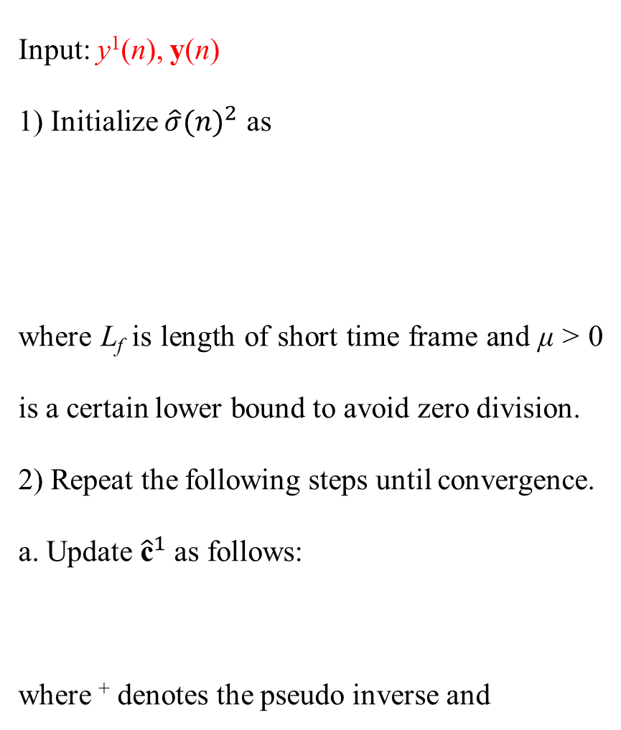
WPE
Input: y¹(n), y(n)
1) Initialize ${\hat{σ}(n)}^{2}$ as
where L_{f} is length of short time frame and μ > 0 is a certain lower bound to avoid zero division.
2) Repeat the following steps until convergence.
a. Update ${\hat{\text{c}}}^{1}$ as follows:
where ⁺ denotes the pseudo inverse and

Slide 12
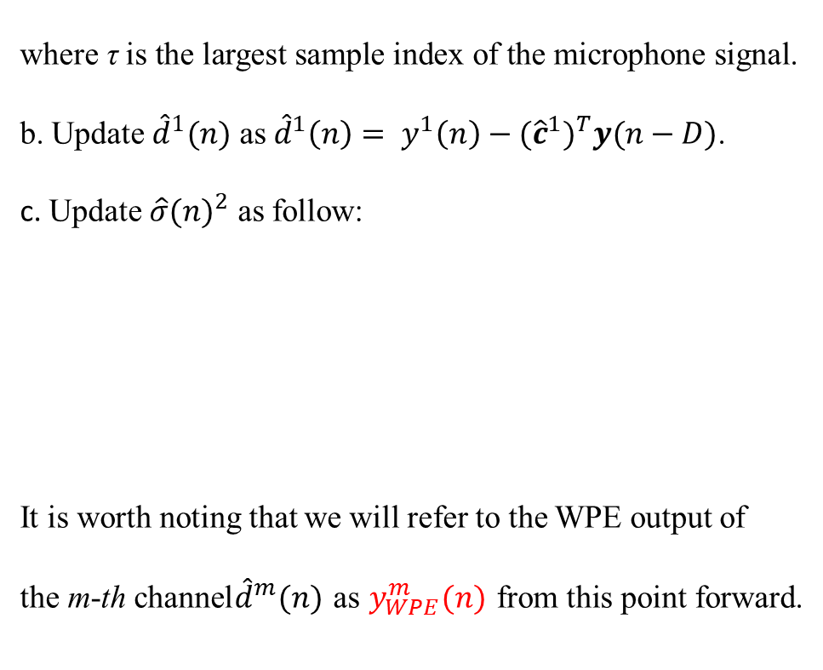
WPE
where τ is the largest sample index of the microphone signal.
b. Update ${\hat{d}}^{1}(n)$ as ${\hat{d}}^{1}\left(n\right)= y^{1}\left(n\right)−{{(\hat{c}}^{1})}^{T}y(n−D)$.
c. Update ${\hat{σ}(n)}^{2}$ as follow:
It is worth noting that we will refer to the WPE output of
the m-th channel${\hat{d}}^{m}(n)$ as $y_{WPE}^{m}(n)$ from this point forward.

Slide 13
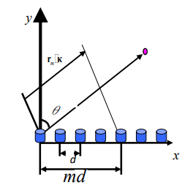
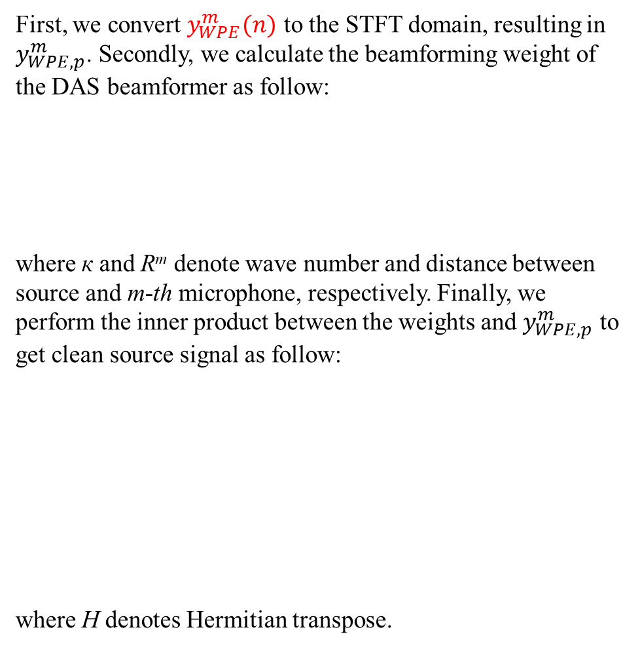
DAS beamformer
First, we convert $y_{WPE}^{m}(n)$ to the STFT domain, resulting in $y_{WPE,p}^{m}$. Secondly, we calculate the beamforming weight of the DAS beamformer as follow:
where к and R^{m} denote wave number and distance between source and m-th microphone, respectively. Finally, we perform the inner product between the weights and $y_{WPE,p}^{m}$ to get clean source signal as follow:
where H denotes Hermitian transpose.
R^{m}

Slide 14
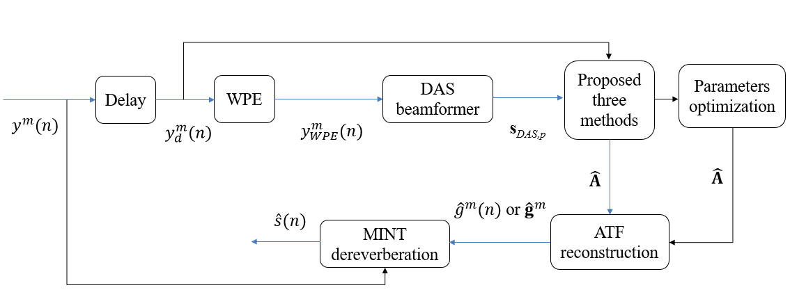
Proposed three methods
Wiener filter approach
RLS approach
Kalman approach

Slide 15
Wiener filter approach

Slide 16
Wiener filter approach
Input: y_{d,p}, s_{DAS,p}
1) Initialize forgetting factor α and covariance matrices as
2) For each instant of frame, p = 1, 2, …, compute

Slide 17
RLS approach
Input: y_{d,p}, s_{DAS,p}
Initialize RLS forgetting factor λ, weight and inverse of correlation matrix as
where ε is a small positive constant
2) For each instant of frame, p = 1, 2, …, compute

Slide 18
Kalman filter approach

Slide 19
Kalman filter approach
Input: y_{d,p}, s_{DAS,p}
Initialize estimated Kalman weight, error covariance matrix, Kalman gain and measurement noise covariance matrix as
where η and ρ is a small positive constant
2) For each microphone, m = 1, 2, …,
For each instant of frame, p = 1, 2, …, compute

Slide 20
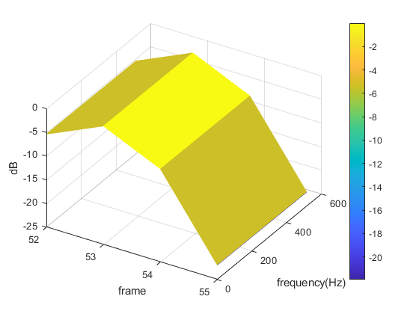
ATF reconstruction
δ_{p}

Slide 21
Parameters optimization
Particle swarm optimization (PSO)
A novel hybrid PSO algorithm using an adaptive strategy (ASPSO)

Slide 22
PSO
Randomly initialize particle locations X and velocities V
Calculate fitness of particle
Update pbest gbest
Stopping criteia met?
Output gbest
Yes
No
Update particle velocities and locations

Slide 23
PSO

Slide 24
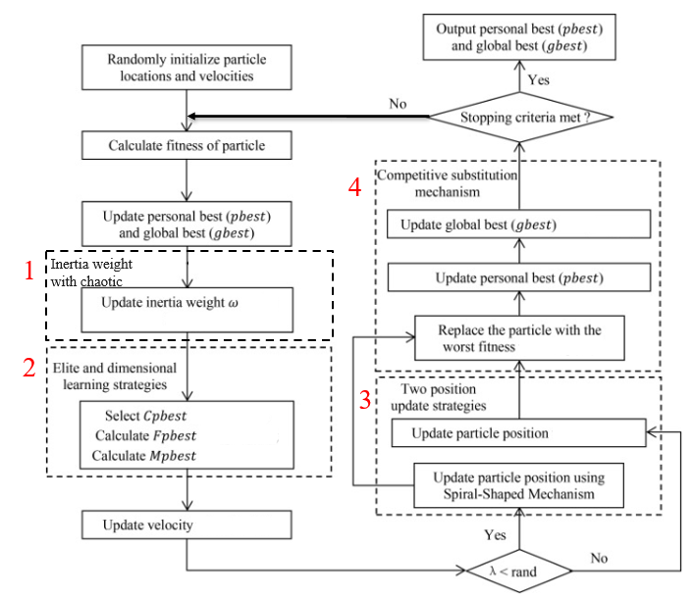
ASPSO

Slide 25
ASPSO
1. Inertia weight with chaotic
2. Elite and dimensional learning strategies

Slide 26
ASPSO
3. Adaptive position update strategy
4. Competitive substitution mechanism

Slide 27
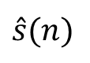
MINT dereverberation
Sound field in a room
a¹(z)
y¹(n)
w¹(z)
a²(z)
y²(n)
w²(z)
$\hat{s}(n)$
s(n)
.
.
.
.
.
.
a^{M}(z)
y^{M}(n)
w^{M}(z)

Slide 28
MINT dereverberation

Slide 29
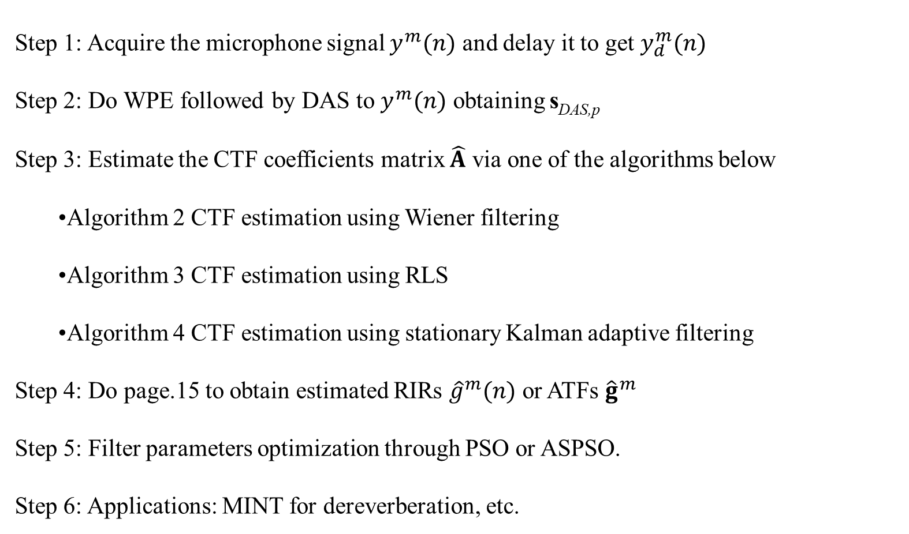
Summary of proposed method
Step 1: Acquire the microphone signal $y^{m}(n)$ and delay it to get $y_{d}^{m}(n)$
Step 2: Do WPE followed by DAS to $y^{m}(n)$ obtaining s_{DAS,p}
Step 3: Estimate the CTF coefficients matrix $\hat{A}$ via one of the algorithms below
Algorithm 2 CTF estimation using Wiener filtering
Algorithm 3 CTF estimation using RLS
Algorithm 4 CTF estimation using stationary Kalman adaptive filtering
Step 4: Do page.15 to obtain estimated RIRs ${\hat{g}}^{m}(n)$ or ATFs ${\hat{g}}^{m}$
Step 5: Filter parameters optimization through PSO or ASPSO.
Step 6: Applications: MINT for dereverberation, etc.

Slide 30
Simulations
Proposed method v.s. State-of-the-art BSI (short RIR)
Without Parameters Optimization (long RIR)
With Parameters Optimization (long RIR)

Slide 31
Simulations
Proposed method v.s. State-of-the-art BSI (short RIR)
Without Parameters Optimization (long RIR)
With Parameters Optimization (long RIR)

Slide 32
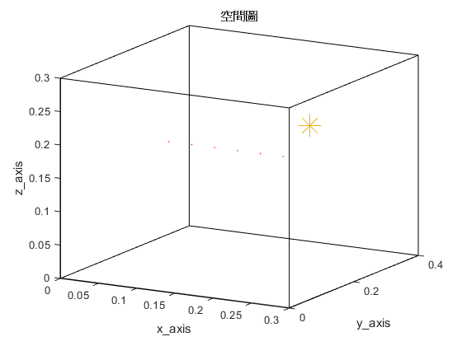
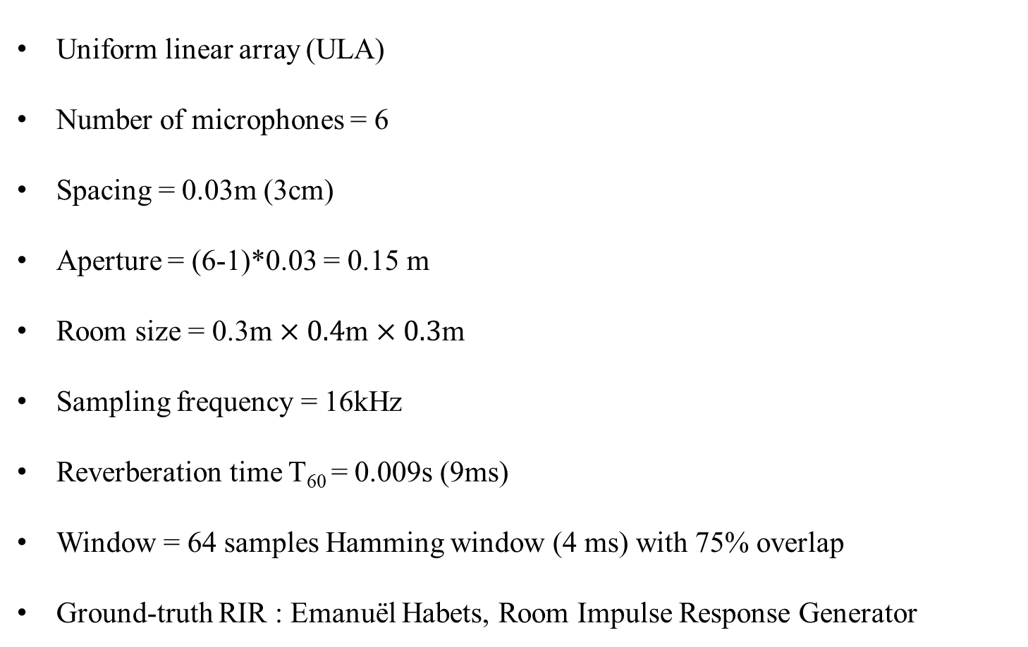
Proposed method v.s. State-of-the-art BSI
Uniform linear array (ULA)
Number of microphones = 6
Spacing = 0.03m (3cm)
Aperture = (6-1)*0.03 = 0.15 m
Room size = 0.3m $×0.4$m $×0.3$m
Sampling frequency = 16kHz
Reverberation time T₆₀ = 0.009s (9ms)
Window = 64 samples Hamming window (4 ms) with 75% overlap
Ground-truth RIR : Emanuël Habets, Room Impulse Response Generator

Slide 33
Proposed method v.s. State-of-the-art BSI
TAEDA
Wiener filter approach

Slide 34
Proposed method v.s. State-of-the-art BSI
RLS
Kalman filter
 | TAEDA | Wiener filter | RLS | Kalman filter
ME | 7.33 | 2.65 | 4.90 | 2.17

Slide 35
Simulations
Compare with state-of-the-art BSI method (short RIR)
Without Parameters Optimization (long RIR)
With Parameters Optimization (long RIR)

Slide 36
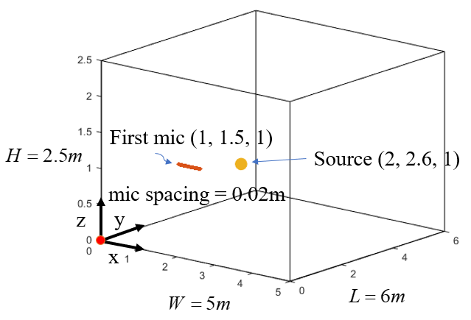
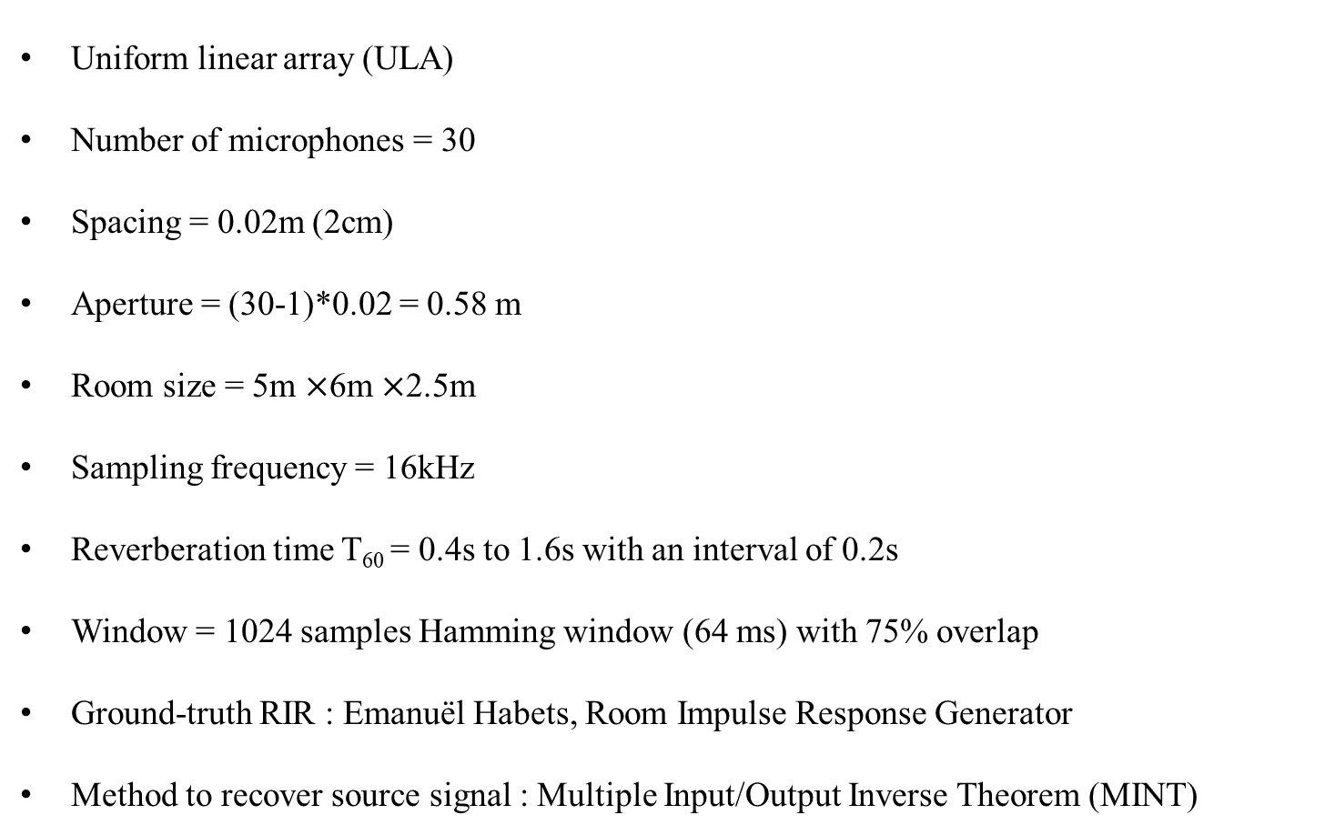
Without Parameters Optimization
Uniform linear array (ULA)
Number of microphones = 30
Spacing = 0.02m (2cm)
Aperture = (30-1)*0.02 = 0.58 m
Room size = 5m $×$6m $×$2.5m
Sampling frequency = 16kHz
Reverberation time T₆₀ = 0.4s to 1.6s with an interval of 0.2s
Window = 1024 samples Hamming window (64 ms) with 75% overlap
Ground-truth RIR : Emanuël Habets, Room Impulse Response Generator
Method to recover source signal : Multiple Input/Output Inverse Theorem (MINT)

Slide 37
Without Parameters Optimization
forgetting factor α in Wiener filter | forgetting factor λ in RLS | ε in RLS | η in Kalman filter | ρ in Kalman filter
0.999 | 0.99 | 0.01 | 0.5 | 0.001
Wiener filter with T₆₀ = 0.6s

Slide 38
Without Parameters Optimization
RLS with T₆₀ = 0.6s
Kalman filter with T₆₀ = 0.6s

Slide 39
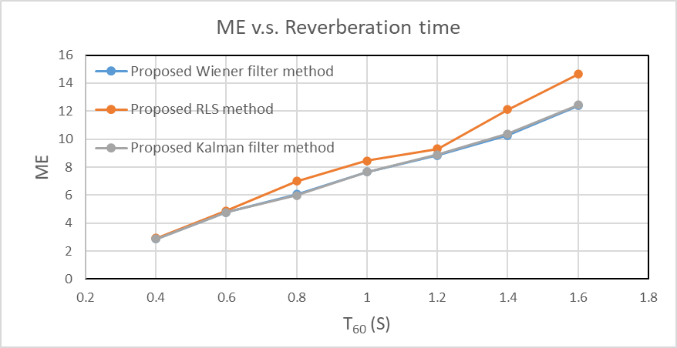
Without Parameters Optimization
T₆₀ (s) method | 0.4 | 0.6 | 0.8 | 1 | 1.2 | 1.4 | 1.6
Wiener filter | 2.86 | 4.76 | 6.05 | 7.66 | 8.83 | 10.26 | 12.37
RLS | 2.91 | 4.87 | 6.98 | 8.46 | 9.30 | 12.12 | 14.63
Kalman filter | 2.86 | 4.76 | 5.97 | 7.64 | 8.90 | 10.37 | 12.43

Slide 40
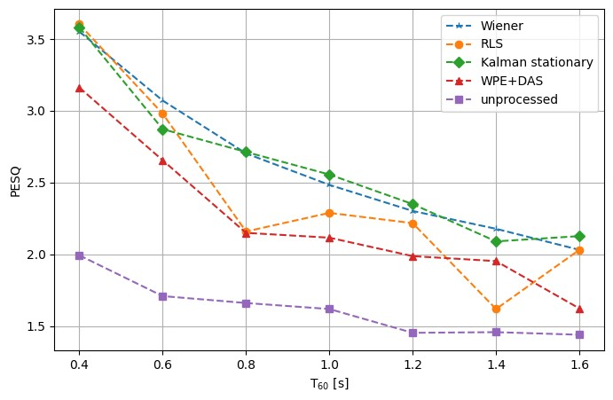
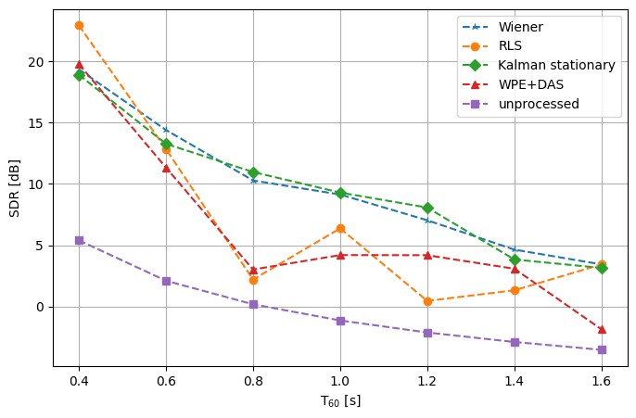
Without Parameters Optimization
SDR (dB)
PESQ

Slide 41
Simulations
Compare with state-of-the-art BSI method (short RIR)
Without Parameters Optimization (long RIR)
With Parameters Optimization (long RIR)

Slide 42
With Parameters Optimization
Here, we take η and ρ in Kalman filter as the parameters needed to be optimized.
Method | ME
Kalman filter without parameters optimization | 5.07
Kalman filter with PSO | 4.97
Kalman filter with ASPSO | 4.94

Slide 43
Summary
Accurate ATF estimation & low ME
Short reverberation times → Outperform State-of-the-art BSI method
Long reverberation times → Outperform WPE following DAS beamformer
Parameters optimization → Lower ME

Slide 44
Future work
Moving sources → Process noise in Kalman non-stationary filter
Real experiments
State-of-the-art BSI → CTF signal model

Slide 45
References
Y. Sato , “ A method of self-recovering equalization for multilevel amplitude-modulaion IEEE Trans. Commu, vol. 23, no. 6, pp. 679-682, 1975.
L. Tong, G. Xu, and T. Kailath, “A new approach to blind identification and equalization of multipath channels,” Proc. 25th Asilomar Conf. Signals, Syst., Comput, vol. 2, pp. 856–860, 1991.
E. Moulines, P. Duhamel, J. F. Cardoso, and S. Mayrargue, “Subspace methods for the blind identification of multichannel FIR filters,” IEEE Trans. Signal Processing, vol. 43, pp. 516–525, Feb. 1995.
H. Liu, G. Xu, and L. Tong, “A deterministic approach to blind equalization,” Proc. 27th Asilomar Conf. Signals, Syst., Comput, vol. 1, pp. 751–755, 1993.
Y. Huang and J. Benesty, “Adaptive multi-channel least mean square and Newton algorithms for blind channel identification,” Signal Processing, vol. 82, no. 8, pp. 1127–1138, Aug. 2002.
M. A. Haque and M. K. Hasan, “Noise robust multichannel frequency-domain LMS algorithms for blind channel identification,” IEEE Signal Processing Letters, vol. 15, pp. 305–308, 2008.
T. Nakatani, T. Yoshioka, K. Kinoshita, M. Miyoshi and B. -H. Juang, “Speech Dereverberation Based on Variance-Normalized Delayed Linear Prediction,” IEEE Trans. Audio, Speech, Lang. Process., vol. 18, no. 7, pp. 1717–1731, 2010.
Rui ang, Kuangrong Hao, Lei Chen, Tong Wang, and Chunli Jiang, “A novel hybrid particle swarm optimization using adaptive strategy,” Information Sciences, vol. 579, pp. 231-250, 2021.
S. A. U. Islam and D. S. Bernstein, “Recursive Least Squares for Real-Time Implementation,” IEEE Control Systems Magazine, vol. 39, no. 3, pp. 82-85, June 2019.

Slide 46


© anchi_0203

